Slide 1




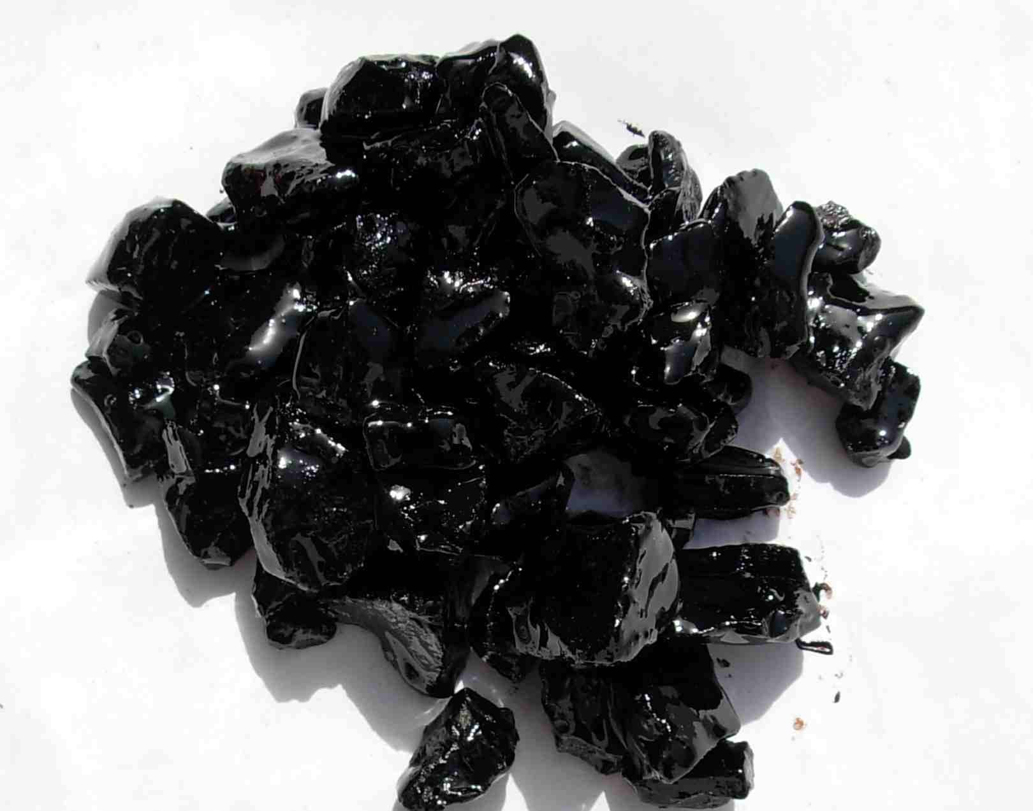
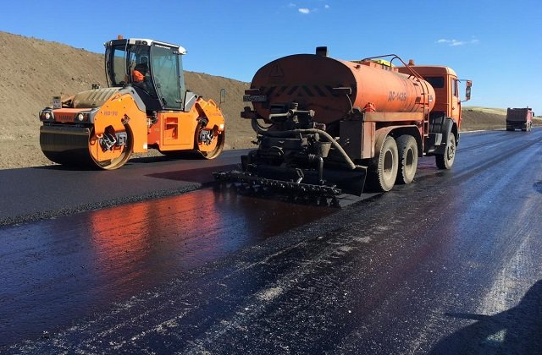
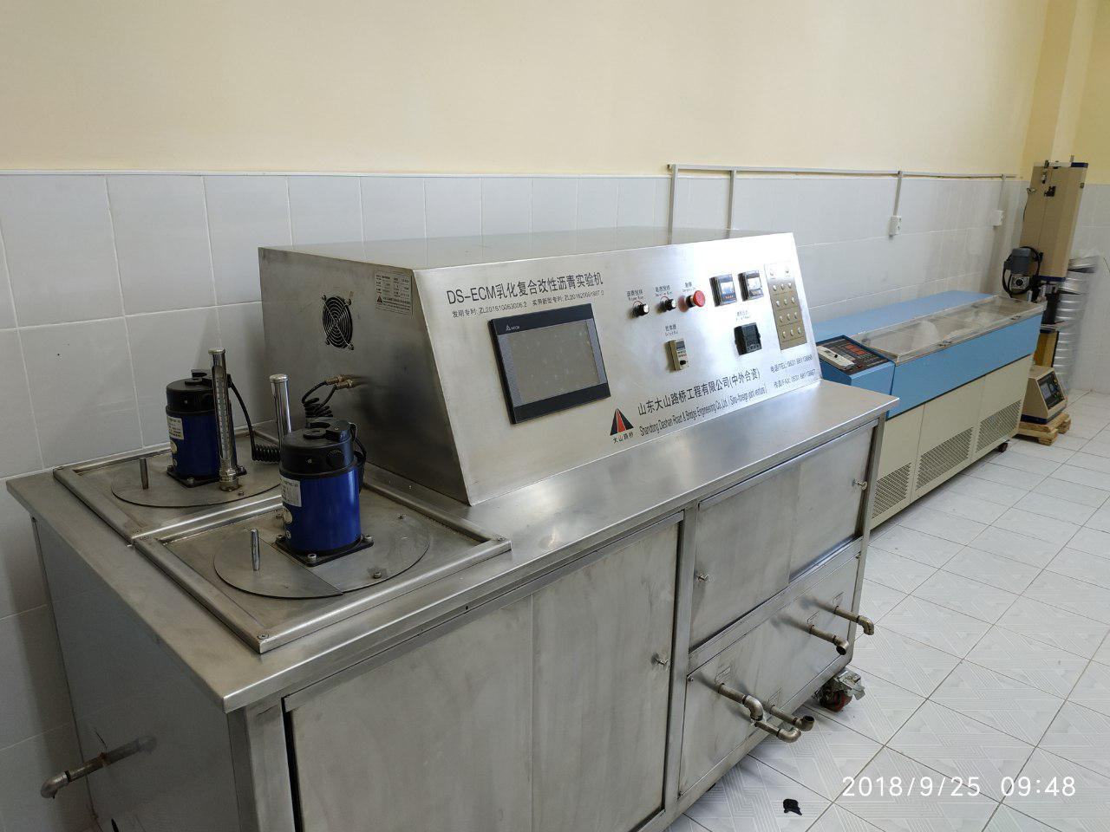

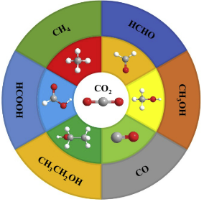
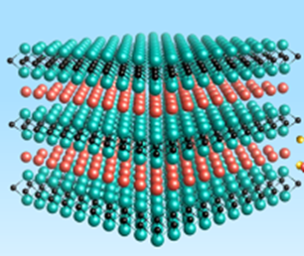



Createdtechnologybased on automated management system was built;
Ministry of Higher Education, Science and Innovations of the Republic of Uzbekistan
Agency for Innovative Development
Academy of Sciences of the Republic of Uzbekistan
Joint research and development of key technologies in the intelligent technological process of modified asphalt production
Implementation period
2024-2026
The recipe of bitumen binders resistant to various weather conditions was obtained and the technology was developed;
Created technology based on automated management system was built;
Total project budget:
$ 76 000
Field of application:
Chemical technologies
Synthesizing technologies for the production of climate-quality asphalt products based on the modification of the composition of local petroleum bitumen
Partners: Ministry of Science and Technology of the People's Republic of China
UNIQUENESS AND COMPETITIVE ADVANTAGE
Modifiers have been proposed for the development of polymer-bitumen compositions for highways based on waste from the oil and gas processing industry, resistant to heat, cold, friction, stretching and compression, and used in harsh continental conditions.
Reducing the cost of road repairs
Ease of use
Long service life
SCALABILITY AND MASS PRODUCTION POTENTIAL
1
Production will be organized through investment on the basis of TCTI with the possibility of certification and export sales.
2
Potential for expansion into neighboring countries and regions.
3
Market entry with a projected sales volume of over
$10 million within 5-6 years.
CONTACTS:
www. tkti.uz
+998 998470867
kdtinfo659@gmail.com
Tashkent c.

